Slide 1
Symptom Checker & Triage Assistant
CAPSTONE PROJECT
Presented By:
Student Name- Shweta Negi
College Name- PC Training Institute
Department- Data Science
4. AICTE ID- STU6a69e86fdbcc01785325679

Slide 2
OUTLINE
Problem Statement
Proposed System/Solution
System Development Approach (Technology Used)
Algorithm & Deployment
Result
Conclusion
Future Scope
References

Slide 3
Problem Statement
Difficulty in assessing symptoms : Patients struggle to determine whether symptoms require self-care, a doctor visit, or emergency care.
Delayed or unnecessary treatment : Lack of proper guidance may cause delayed treatment or unnecessary emergency visits.
Need for quick preliminary guidance : Users need an accessible system for immediate symptom assessment and triage recommendations.
Lack of reliable symptom interpretation : Online symptom searches often provide confusing information without indicating urgency.
Limited access to preliminary triage : There is a need for an accessible tool that helps users understand symptom severity and appropriate next steps.

Slide 4
Proposed Solution
Symptom Input System : Users enter symptoms along with relevant health information such as age, symptom duration, severity, medical history, and current medications.
AI-Powered Analysis : Gemini AI analyzes the user-reported symptoms and identifies possible conditions and potential risk factors.
Triage Recommendation : The system classifies cases into Self-Care, See a Doctor, or Emergency Care based on the analysis.
Personalized Guidance : Provides an urgency score, possible conditions, red flags, self-care tips, and guidance on when to escalate care.
Safety Disclaimer : Clearly states that the AI assessment is for preliminary guidance and does not replace professional medical advice.

Slide 5
System Approach
Frontend : Streamlit
Backend : Python
AI Assisted Development : IBM Bob
Processing : User input is processed using AI
Output : Results are displayed through Streamlit
Flow : -
User Input → Streamlit → Python + IBM Bob → AI Processing → Output

Slide 6
Algorithm & Deployment
AI Algorithm : The system uses Google Gemini AI to analyze user-reported symptoms and generate health-related insights.
Data Input : Users provide symptoms along with age, biological sex, symptom duration, severity, medical history, and current medications.
AI Analysis : The AI processes the patient information and identifies possible conditions and potential risk factors.
Triage Classification : Based on the analysis, the system categorizes cases into Self-Care, See a Doctor, or Emergency Care.
Results & Deployment : The web application displays urgency scores, possible conditions, red flags, self-care tips, and escalation guidance, and can be deployed as a browser-based application

Slide 7
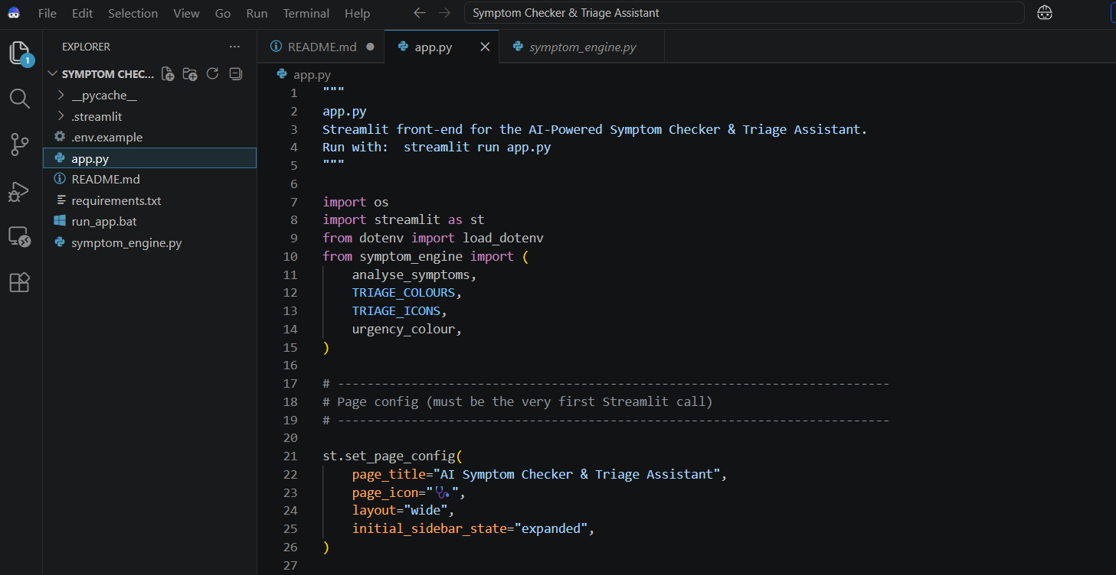
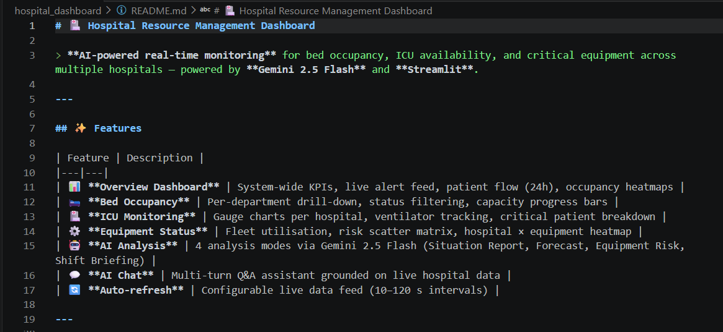
Result

Slide 8
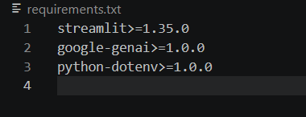
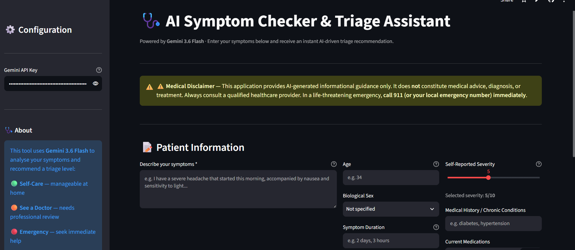
Result

Slide 9
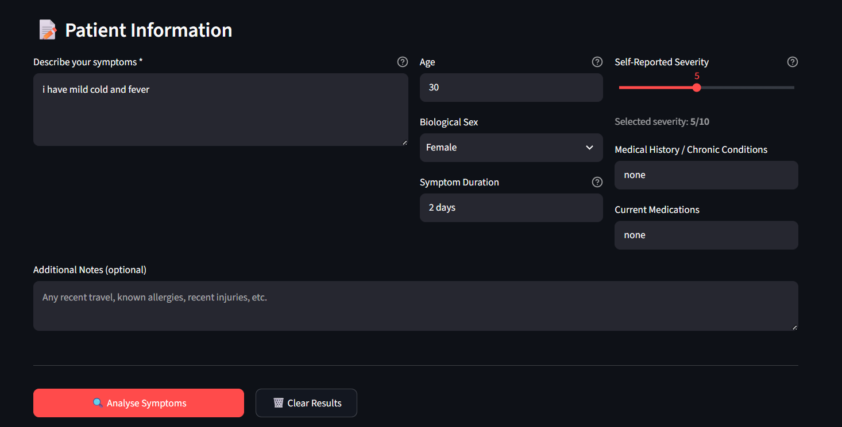
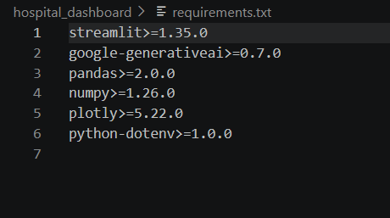
Result

Slide 10
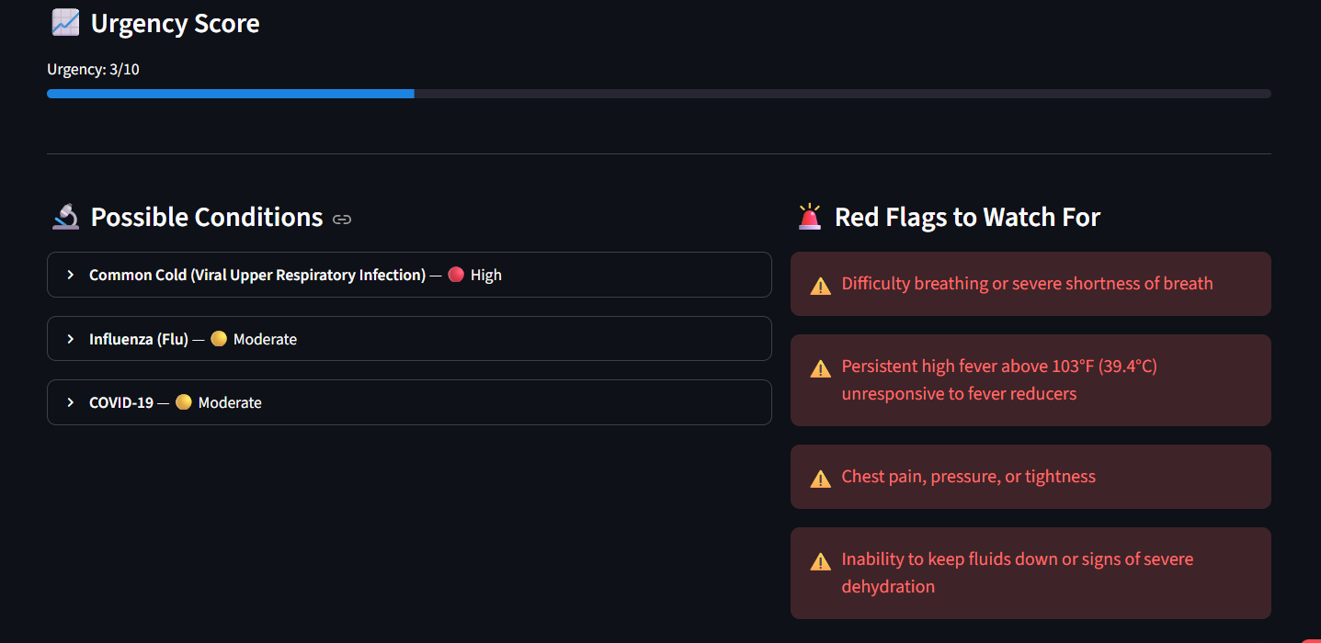
Result

Slide 11
Conclusion
The project provides an AI-powered preliminary symptom assessment system to help users better understand their health concerns.
By analyzing user-reported symptoms and relevant health information, the system identifies possible conditions and potential risk factors.
It provides triage recommendations by categorizing cases into Self-Care, See a Doctor, or Emergency Care.
The system also generates urgency scores, red flags, self-care tips, and escalation guidance.
This solution demonstrates how Generative AI can support preliminary health guidance, while emphasizing that it does not replace professional medical advice.

Slide 12
Future scope
Medical Dataset Integration : Incorporate verified medical datasets and clinical guidelines to improve assessment reliability.
User History Tracking : Allow secure tracking of previous symptom assessments and health trends.
Healthcare Integration : Integrate with hospitals or telemedicine platforms for direct consultation when required.
Improved AI Models : Continuously enhance the system using advanced AI models and medically validated knowledge.
Multilingual Support : Extend the application to support multiple languages, making it accessible to a wider range of users.

Slide 13
References
Google Gemini API Documentation: Used for integrating Generative AI capabilities for symptom analysis and preliminary health guidance.
World Health Organization (WHO): Referenced for general health information and healthcare guidance.
Python Documentation: Used for backend development and application implementation.
Streamlit Documentation: Used for developing and deploying the interactive web application interface.
GitHub: Used for version control and project source code management.

Slide 14
Deployment link / github link
GitHub Link : https://github.com/shweta67-ctrl/-Symptom-Checker-Triage-Assistant.git
Deployment Platform : Streamlit ( https://idxmbalsrmir9x3z8pjxrj.streamlit.app/ )

Slide 15
THANK YOU

